Slide 1

The Air You Are Breathing – Do you know how safe it is?

Slide 2


Poor Indoor Air Quality is the World’s BIGGEST Environmental Killer

Slide 3
Every Year 4 Million People Die Prematurely From Indoor Air Pollution

Slide 4
Indoor Air Pollution Is Dangerous
Indoor air pollution concentrations can be 3-5x higher than outdoor concentrations, occasionally more than 100 times highers
Americans spend 90% of their time indoors

Slide 5


Negative Impact of IAQ Starts Before a Child’s Birth
Higher rate of preterm birth
Low birth weight
Neurobehavioral disorders to the baby including attention deficits, reduced IQ, learning and memory deficiencies
Abnormal development
Congenital defects
Childhood asthma
Infant mortality

Slide 6
Indoor Air Pollution Is Costly
lead to slow performance, fatigue, difficulty concentrating, and impairs executive function. (Allen et al.)
A study by Harvard University indicates that improving air quality can double cognitive skill scores!
Billions of Dollars Lost Every Year

Slide 7
The Solution

Slide 8
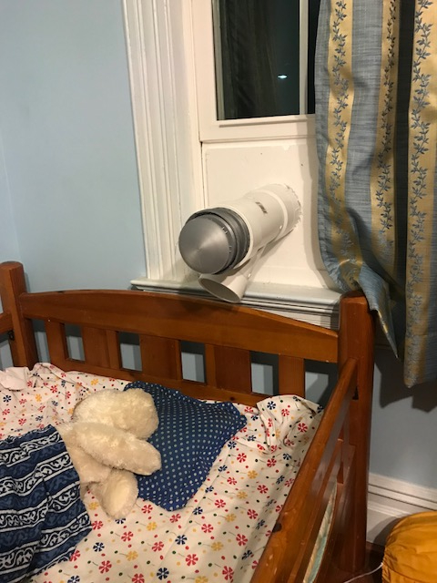

Introducing Personalized Ventilation: An Affordable, Scalable, Replicable Solution Driven by IAQ Sensors

Slide 9
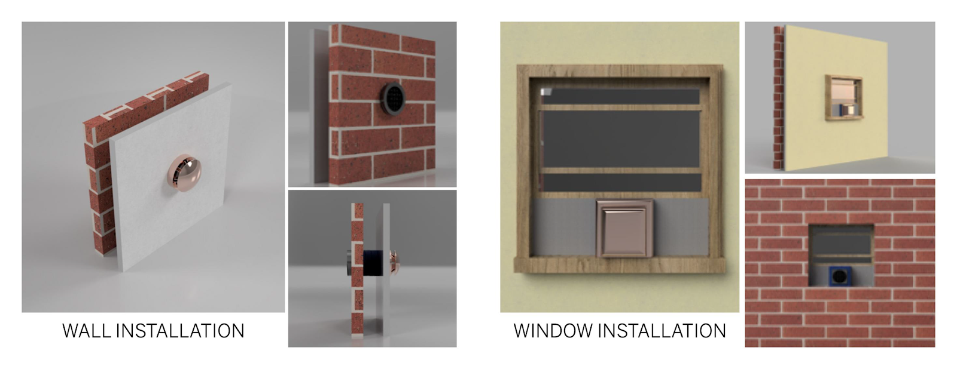
Installation

Slide 10
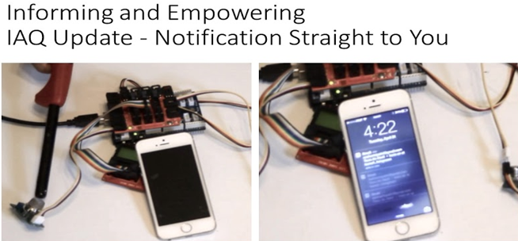

HOW IT WORKS
Display
AWS
CLOUD
Representative Room
Inlet for external air
Outlet for exhaust
Air Quality Sensor
FIG. 1: Deployment of Environmentally Efficient Air Quality Network

Slide 11
Measure Internal Air Quality (IAQ) Parameters
User Inputs IAQ Values
Transmitting IAQ Parameters to IAQ Index
Storing IAQ Parameters in Cloud
Comparing IAQ Parameters against Pre-Determined/User-Defined Values
Threshold
Below, No Action
Check External Conditions (AIRNOW)
FIG. 2: IOT Control Chart for Environmentally Efficient Air Quality Network
Take Action: Use Fan and/or Exhaust

Slide 12
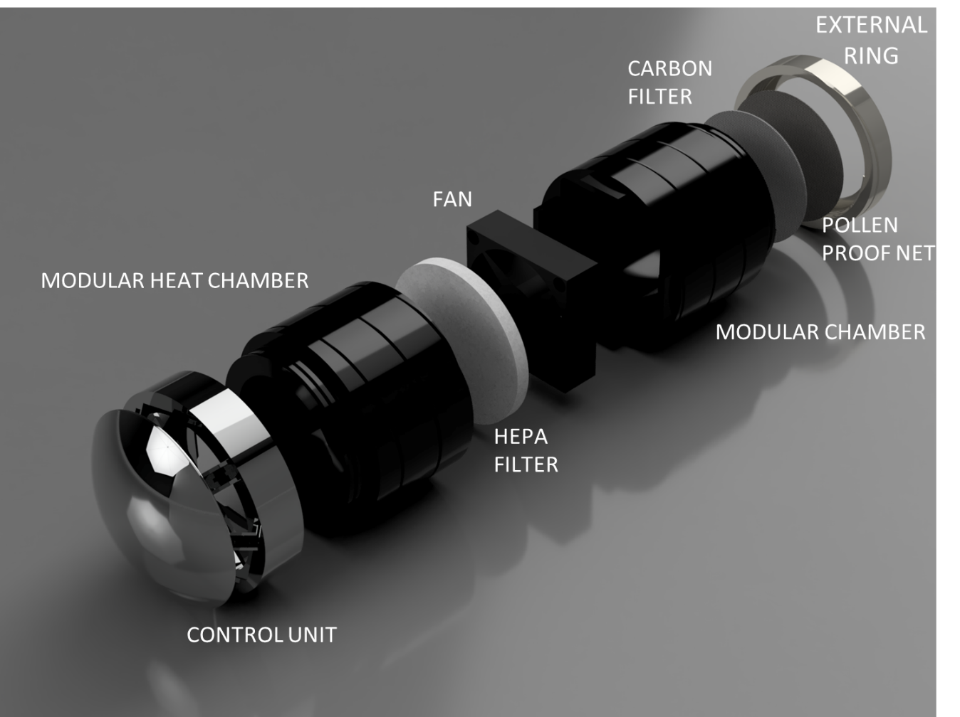

Slide 13
IAQ Sensor Board (VOC, CO, PPM etc.)
Temperature and Pressure Sensor
Transmitter
Microcontroller/
General Purpose CPU
RF Transmitter
Humidity Sensor
Power Source

Slide 14
Ventilation Fan
Heating Module
Relay
Microcontroller/
General Purpose CPU
RF Receiver
Heating Module
Power Source

